Slide 1
TKTS Booth Sales Analysis And Forecasting
Jonathan Calindas
Springboard Data Science Intensive Capstone Project
May 5, 2017

Slide 2
Study Parameters
Study dates: 1/1/2016 to 12/31/2016
Historical data: 1/1/2013 to 12/31/2015
Units of sale: number of tickets sold per week.

Slide 3
Study Objectives
Examine data for insights into the behavior of sales at the booths.
Assemble a model of sales at the booth
Use the model to forecast sales and use actual sales numbers to determine the accuracy of the forecast.

Slide 4
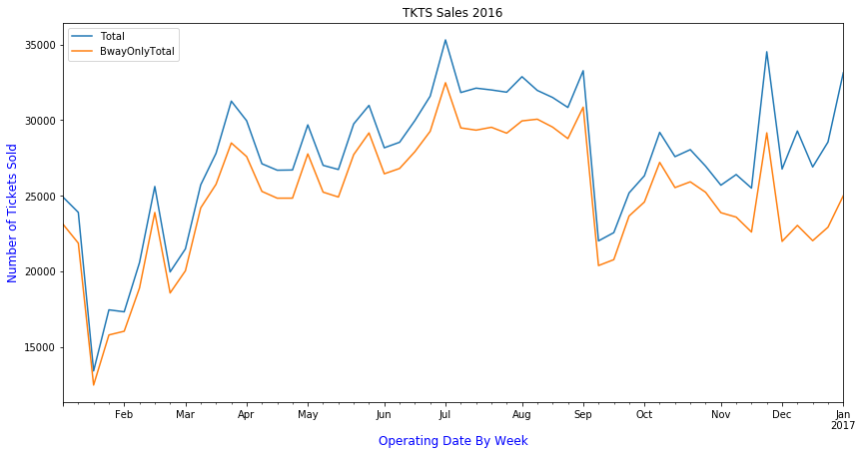
TKTS Sales 2016
Peak sales – summer
Lowest sales – January
“Death drops” – Early January and Early September
Sales spike during certain holidays:
Valentine’s Day
Easter (Apr 16)
Memorial Day
Fourth of July
Thanksgiving
Christmas/New Years
Broadway shows make up the great majority of ticket sales. Ratio remains constant through the year until Nov-Dec. (Radio City?)

Slide 5
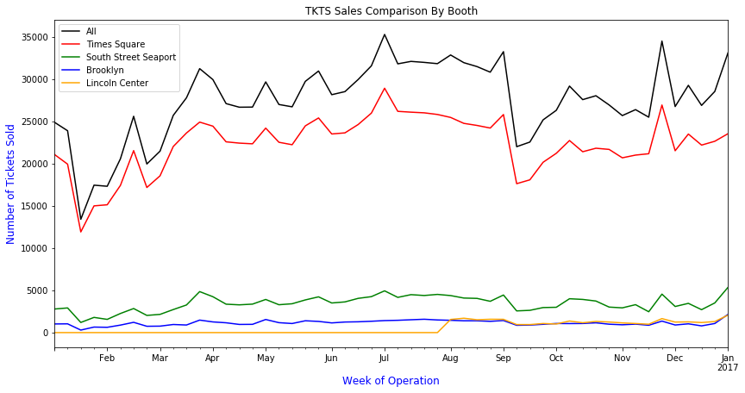
Sales By Booth - 2016
Lincoln Center opened late July
For the most part the booths sell at the same ratio and rise and dip the same way in all 4 booths.

Slide 6
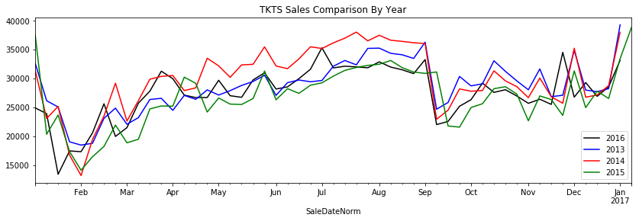
Sales Comparison By Year

Slide 7
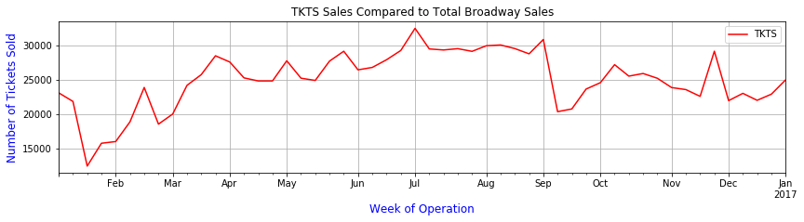
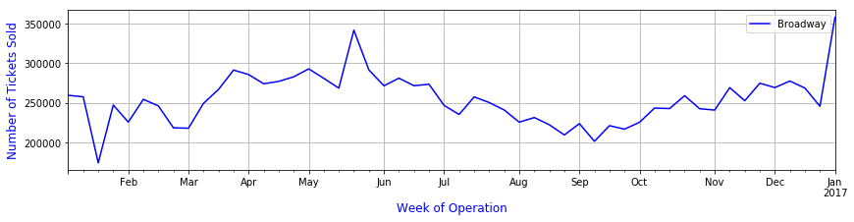
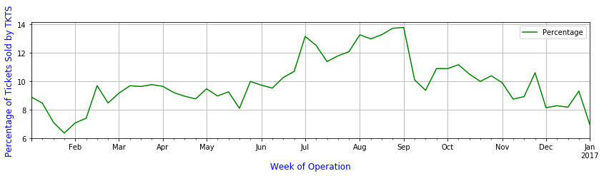
TKTS vs Broadway

Slide 8
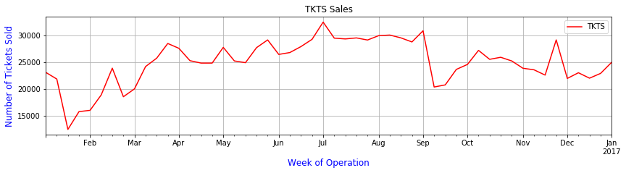
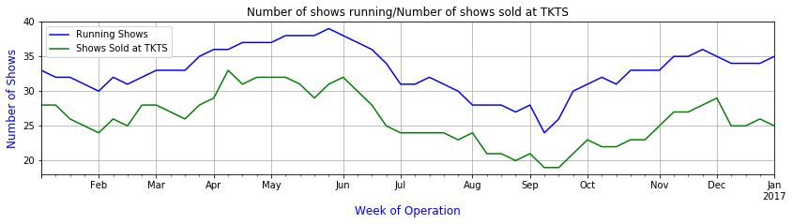
Number of Broadway Shows Running vs Sales

Slide 9
Creating a Model to Forecast Sales
Our data is known as a time-series, a set of values that fluctuate over time.
To model this data, we will create an ARIMA model (Autoregressive Integrated Moving Average)
Our model can then be used to generate a forecast for future years.

Slide 10
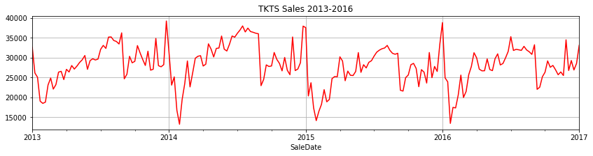
Historical Data Set
The plot for each year follows a basic pattern, indicating seasonality.
Slight upward trend in 2014 and downward trend in 2015

Slide 11
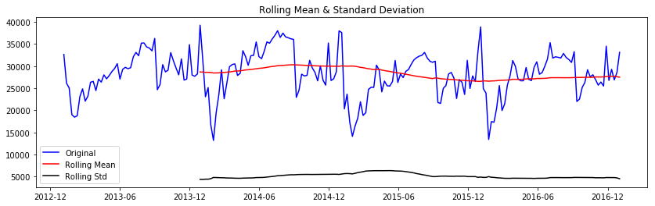
Is the Time-Series Stationary?
Dickey-Fuller Test Results Test Statistic -3.431417
p-value 0.009933
Critical Value (1%) -3.463645
Critical Value (5%) -2.876176
Critical Value (10%) -2.574572
Stationarity is a requirement to create an ARIMA model
A time-series is stationary if the mean and the variance remain constant over time.
A method of calculating stationarity is the Dickey-Fuller Test

Slide 12
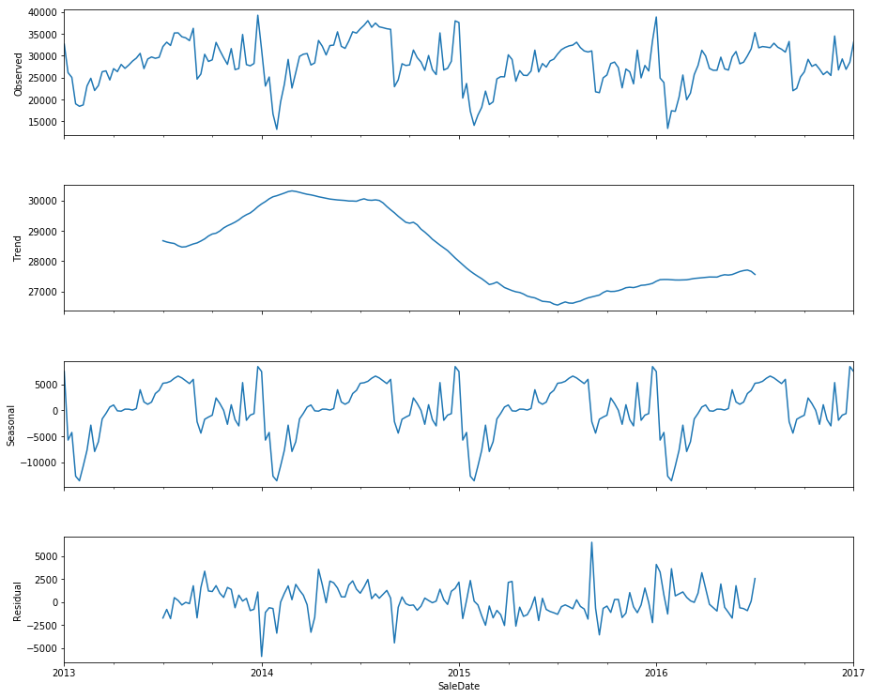
Time Series Decomposition
To apply the ARIMA model to our time-series, we will remove the effects of trend and seasonality from our data.
The remaining data, the residuals, will be used to build the ARIMA model.

Slide 13
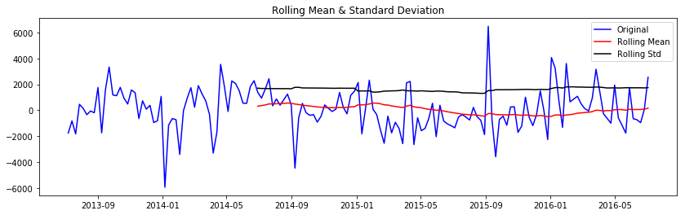
Stationarity of Residuals
Dickey-Fuller Test Results Test Statistic -4.188552
p-value 0.000689
Critical Value (1%) -3.473830
Critical Value (5%) -2.880623
Critical Value (10%) -2.576945

Slide 14
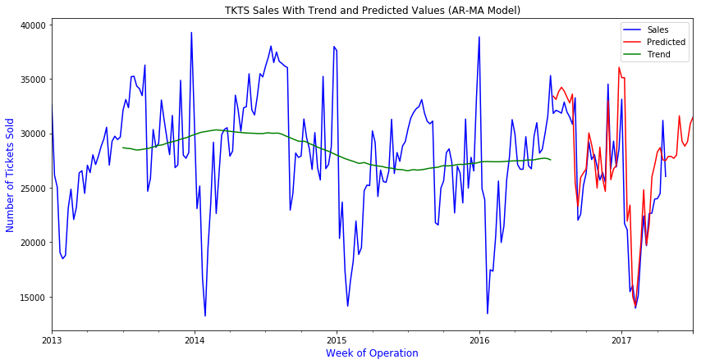
Predicted Values vs Actual Sales
After the ARIMA model is calculated, we add back the seasonality and trend to create our forecast (in red).

Slide 15
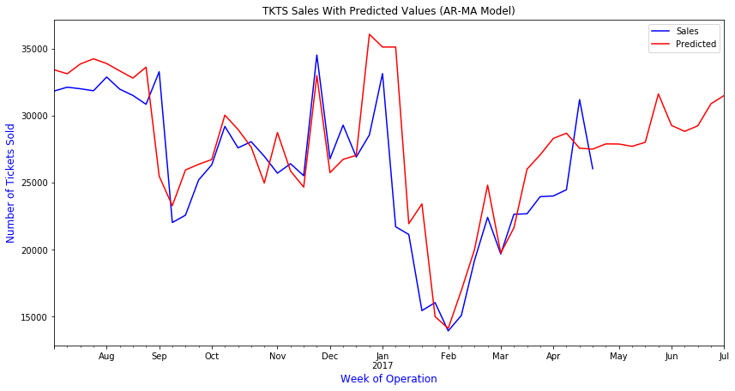
Close-up of Predicted Values vs Actual Sales
Root mean squared error: 3503.468
(Our predictions will, on average be approx. 3503 tickets away from the predicted values.)

Slide 16
Conclusions
Analyzing the sales from 2016 and from the past 3 years, we can build a model of behavior of sales at the TKTS booths from a year to year basis and can detect severe anomalies when they happen.
We know that sales at the booth follow a seasonal trend every year and that sales spike around holidays, such as Valentines Day, Easter, and Thanksgiving.
Sales at the booth are at their highest during the summer and at the month of December.
We can see that the general trend up or down between years is about 3,000 tickets, at least based our data. We can further generalize this trend if we go back several more years.
Our root mean squared error on our model states that we will be off on our predictions an average of about 3,500 tickets. But since our sales can go from 13,000 to 39,000, this is a fairly accurate model.

